Slide 1


"Project Communication Management"

Slide 2

Outline
Introduction
Importance of Communication in Projects
Key Processes in Communication Management
Tools and Techniques
Inputs and Outputs
Challenges in Project Communication
Best Practices for Effective Communication
Conclusion

Slide 3

The power of communication “Communication is the bridge that turns ideas into action and dreams into reality.”

Slide 4

Introduction to Project Communication Management
Project Communication Management involves processes and activities to ensure timely, accurate, and effective exchange of information among project stakeholders.
Key Objectives:
Ensure all stakeholders receive the necessary information.
Facilitate collaboration to meet project goals.
Minimize miscommunication and conflicts.
Interesting Fact: “Poor communication is cited as a leading factor in 30% of project failures.”

Slide 5
Importance of Good Communication
Key Points:
Bridges cultural and organizational gaps.
Ensures team alignment and reduces confusion.
Builds trust among stakeholders.
Real-Life Example: The Challenger Space Shuttle disaster (1986) partially resulted from a failure in effective communication about critical safety concerns.

Slide 6
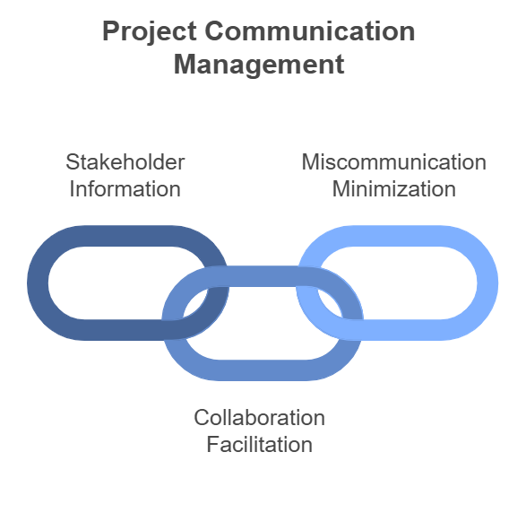

Slide 7
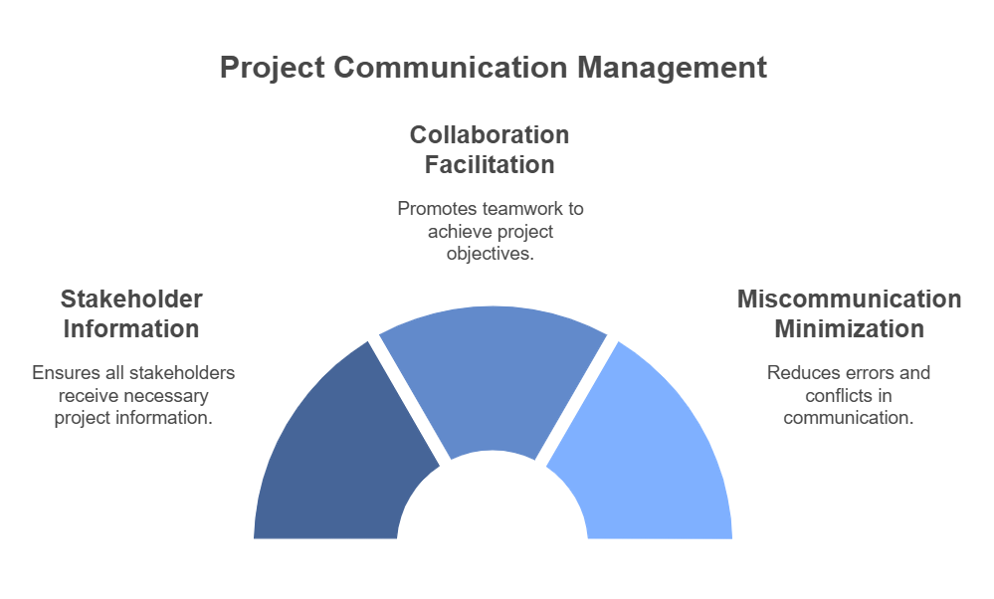

Slide 8
Communication Management Process
Plan Communications Management
Manage Communications
Monitor Communications

Slide 9
Communication Management Processes
Plan Communications Management
Purpose: Create a tailored communication plan to address stakeholder needs.
Steps:
Identify stakeholders and their communication needs.
Select communication tools and methods (e.g., meetings, emails, reports).
Define frequency and responsibility for communication.
Output: Communication Management Plan.
Manage Communications
Purpose: Execute the communication plan and distribute information effectively.
Tools:
Email systems for documentation.
Collaborative tools like Slack, Microsoft Teams.
Video conferencing for real-time updates.
Monitor Communications
Purpose: Assess and ensure communication needs are met throughout the project lifecycle.
Methods: Stakeholder surveys, observation, and feedback loops.

Slide 10
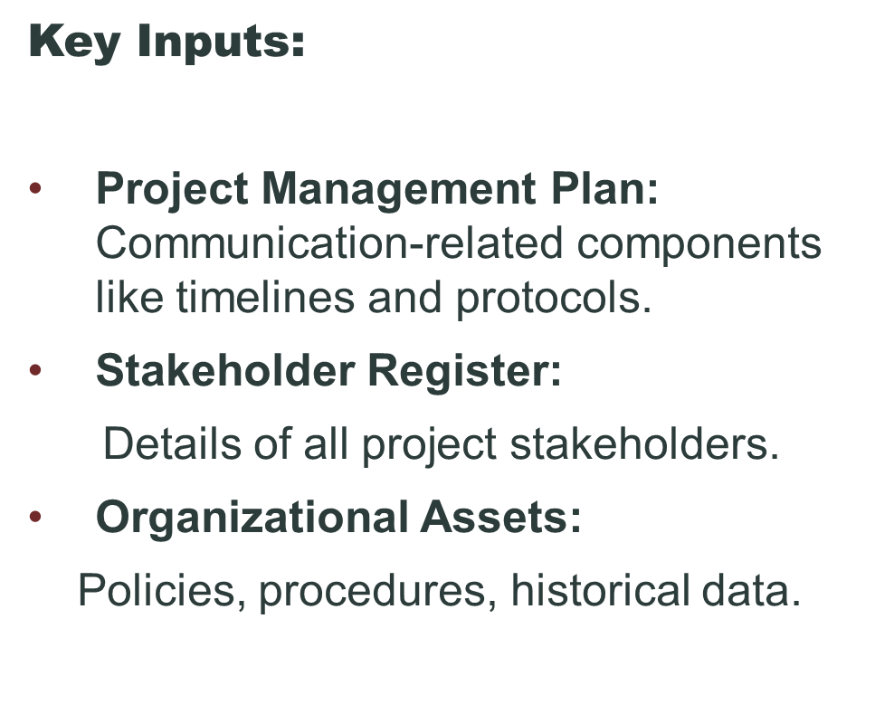
Inputs to Manage Communication

Slide 11

Tools and Techniques
Communication Requirements Analysis: Determine the type and frequency of communication needed.
Technology Selection:
Example: Use Zoom for virtual meetings, Google Docs for document sharing.
Communication Methods:
Push: Emails or reports sent to stakeholders.
Pull: Information stored on portals for stakeholders to access as needed.
Interactive: Real-time discussions via meetings or calls.

Slide 12
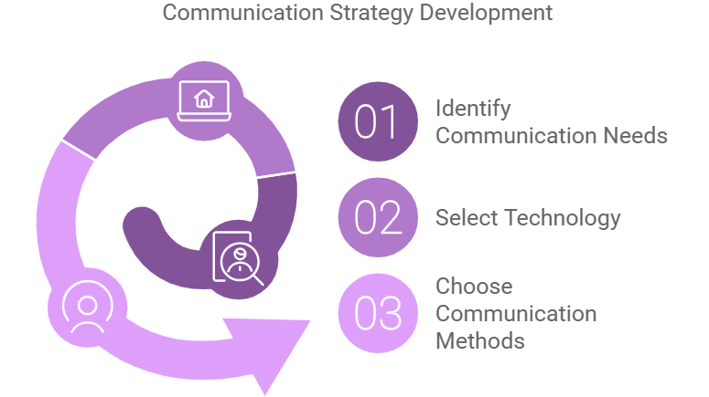

Slide 13
Outputs from Manage Communication
Deliverables:
Progress Reports: Updates on milestones, deadlines, and risks.
Logs: Issues or decision logs for transparency.
Examples: Weekly status updates, project newsletters.

Slide 14
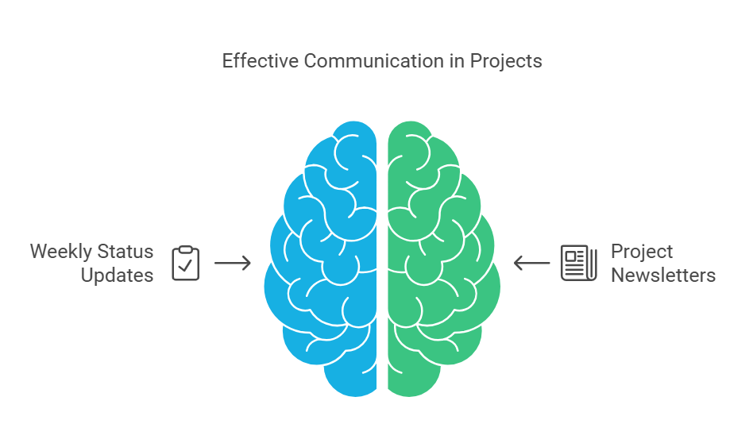

Slide 15
Challenges in Communication Management
Cultural Barriers: Language differences or work style disparities.
Technology Misuse: Over-reliance on tools can cause misunderstandings.
Stakeholder Misalignment: Different expectations or priorities.
Solution: Regular check-ins and active listening.

Slide 16
Best Practices for Effective Communication
Clarity: Ensure all messages are clear and concise.
Engagement: Use visuals like charts and infographics for better understanding.
Feedback Loops: Encourage open dialogue to confirm understanding.
Tools: Adopt modern tools like Trello or Asana for streamlined communication.

Slide 17
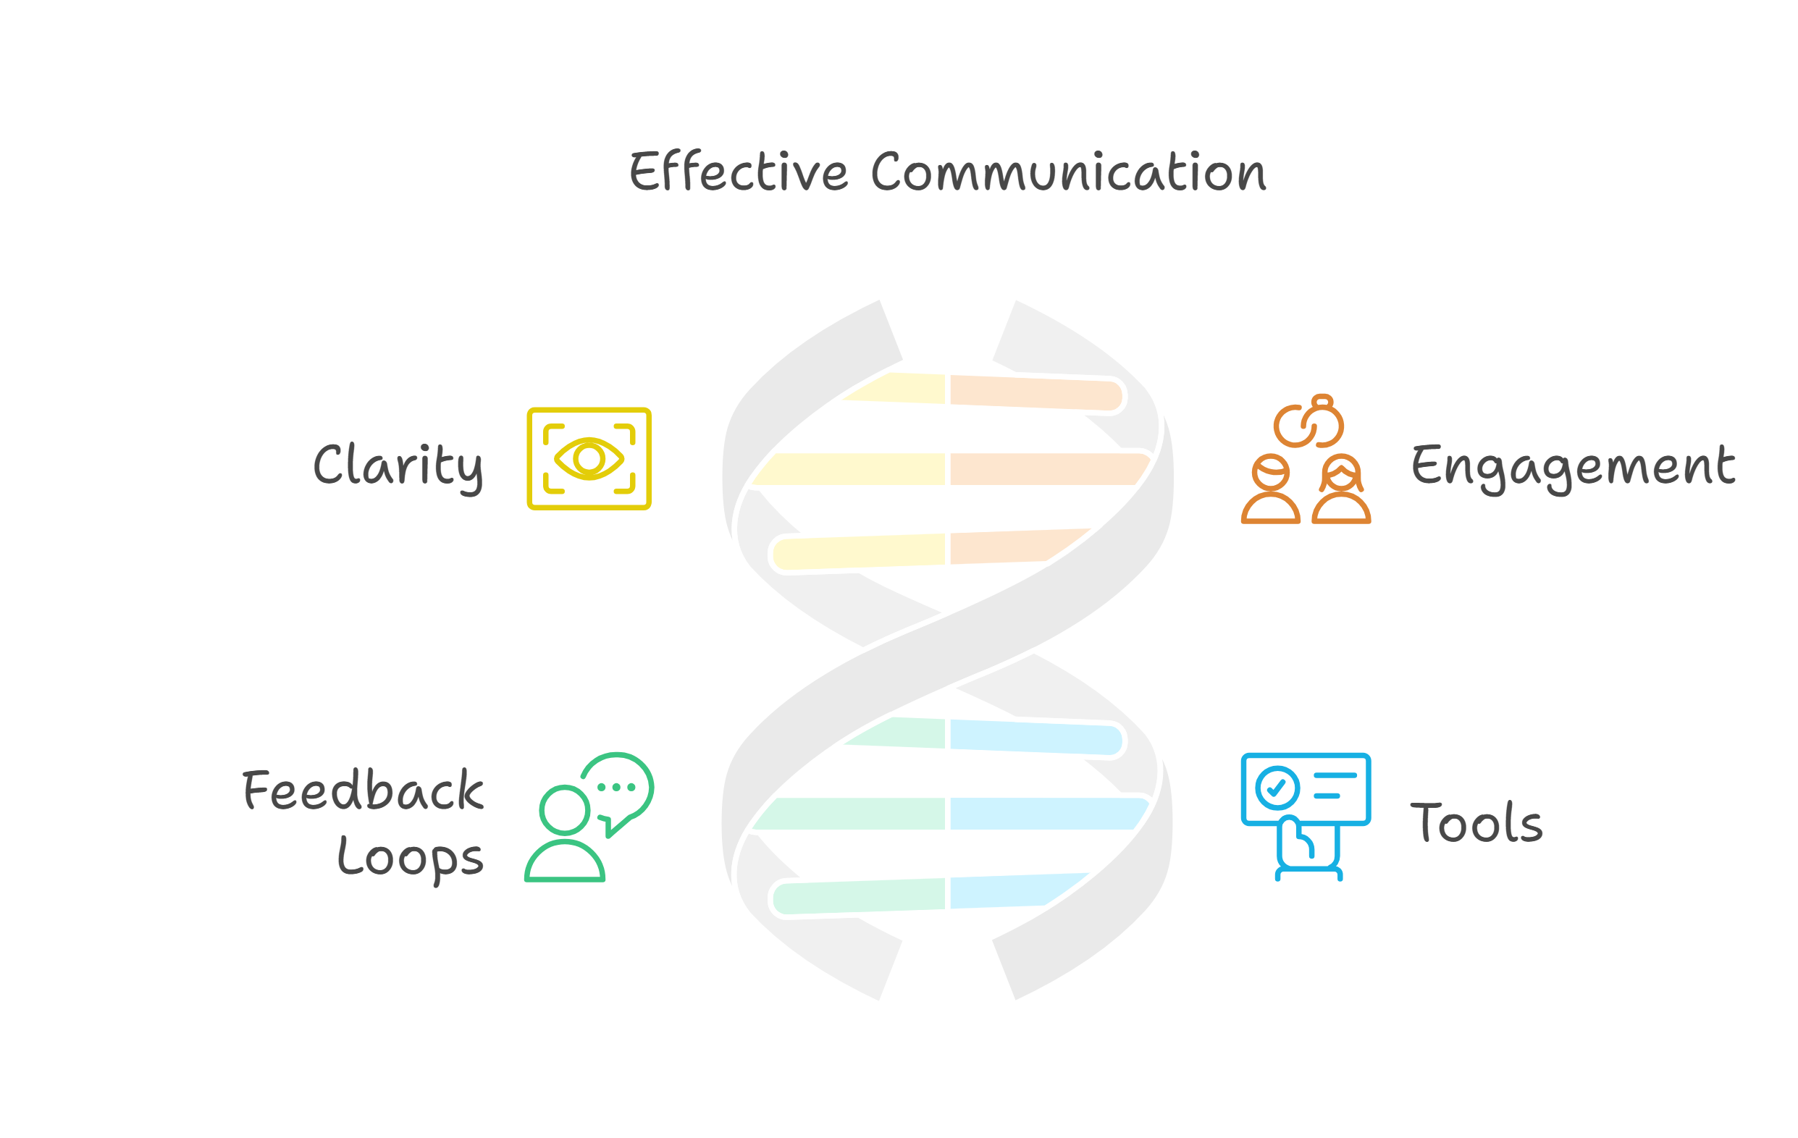

Slide 18
Conclusion
Communication is a cornerstone of project success.
With proper planning and management, you can avoid conflicts and ensure project goals are achieved.
Focus on transparency and stakeholder involvement.

Slide 19
Thank you

